Slide 1


Tips and Tricks for Developing and Debugging Apps
Heather Gonzago and Kelly Hutchins
2022 ESRI DEVELOPER SUMMIT
Notes:
Learn how to quickly and easily find and fix problems in your web mapping applications. You will learn how to setup your dev environment to use plug-ins like linters and beautifiers to write cleaner code. We'll show you how to use the power of browser-based debugging tools to debug, style, and optimize your apps. We will also cover how to resolve common issues you may run into when working with the ArcGIS API for JavaScript.

Slide 2

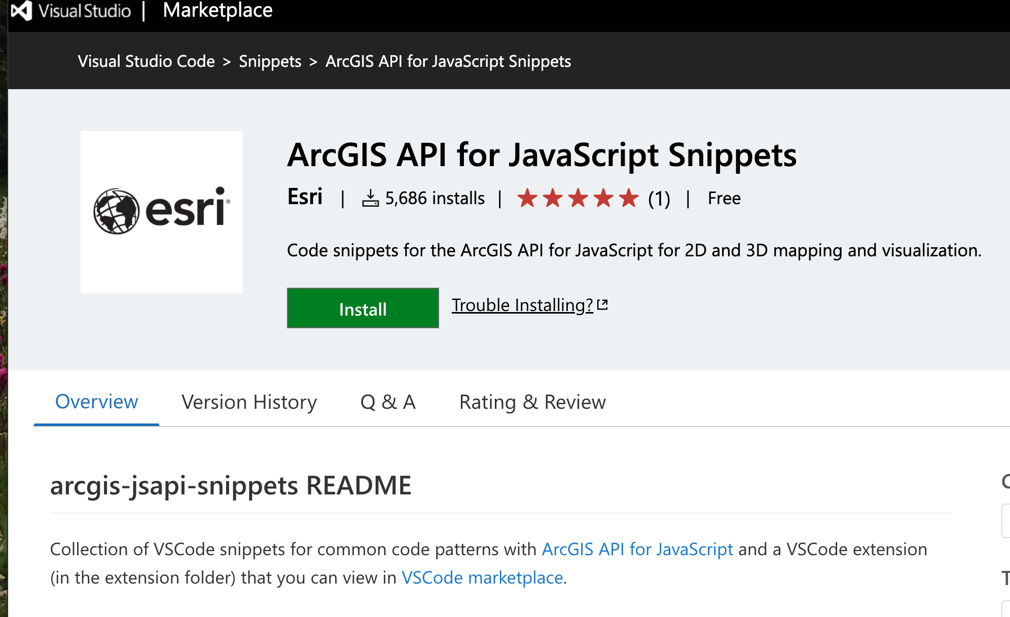
Shortcuts
Emmet
Code snippets
ArcGIS API for JavaScript Snippets

Slide 3
Live Server
Visual Studio Code Extension

Slide 4
Set the view’s lat/long

Slide 5
Interceptors

Slide 6
Force json on client
https://codepen.io/matt9222/pen/NWgLpPV?editors=1000

Slide 7



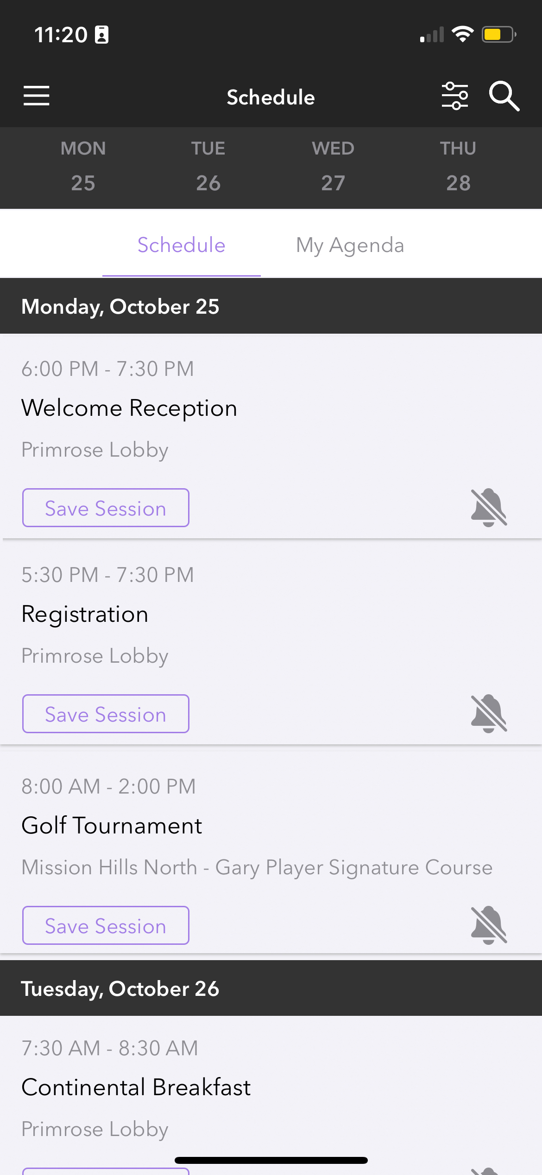
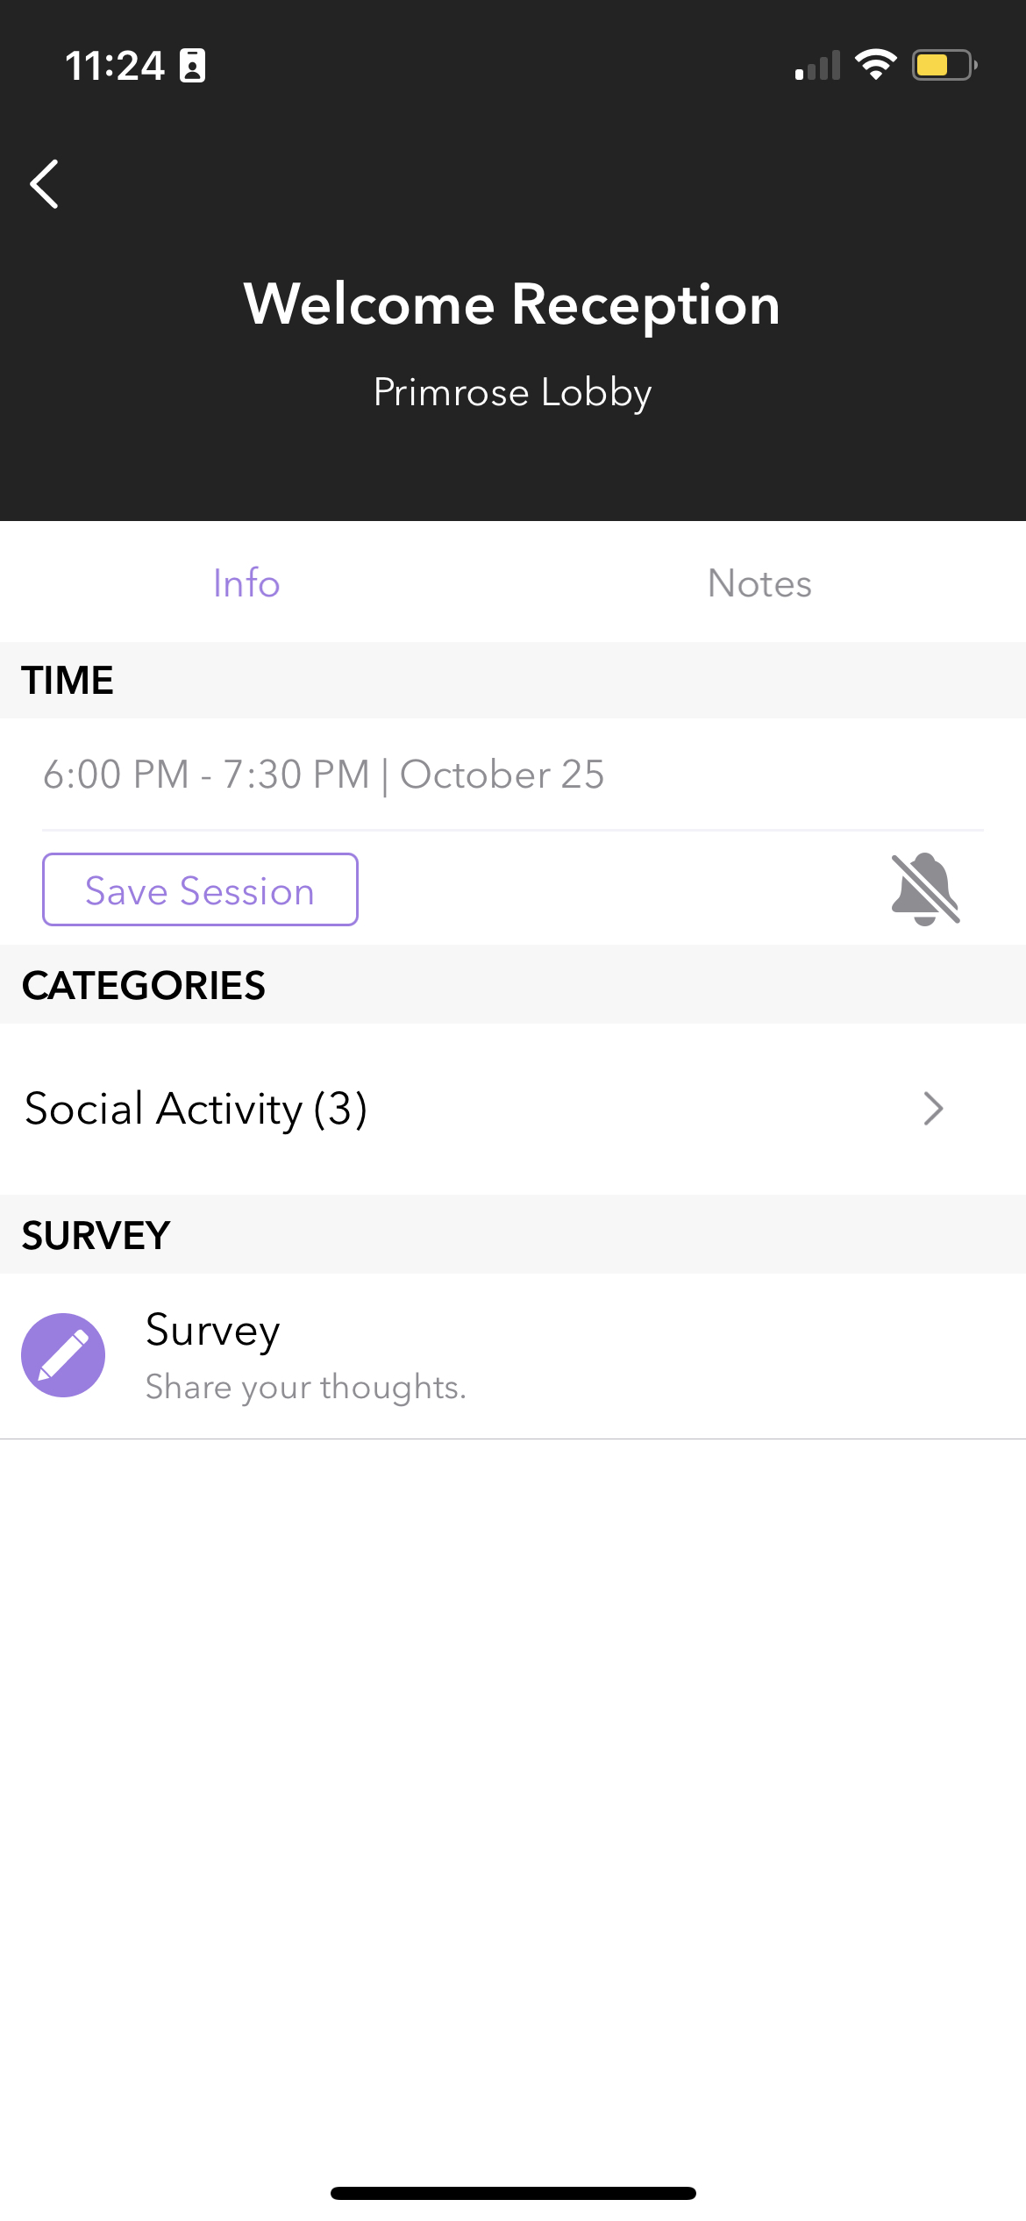
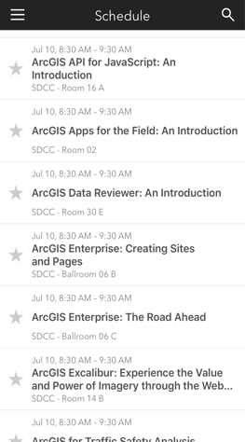
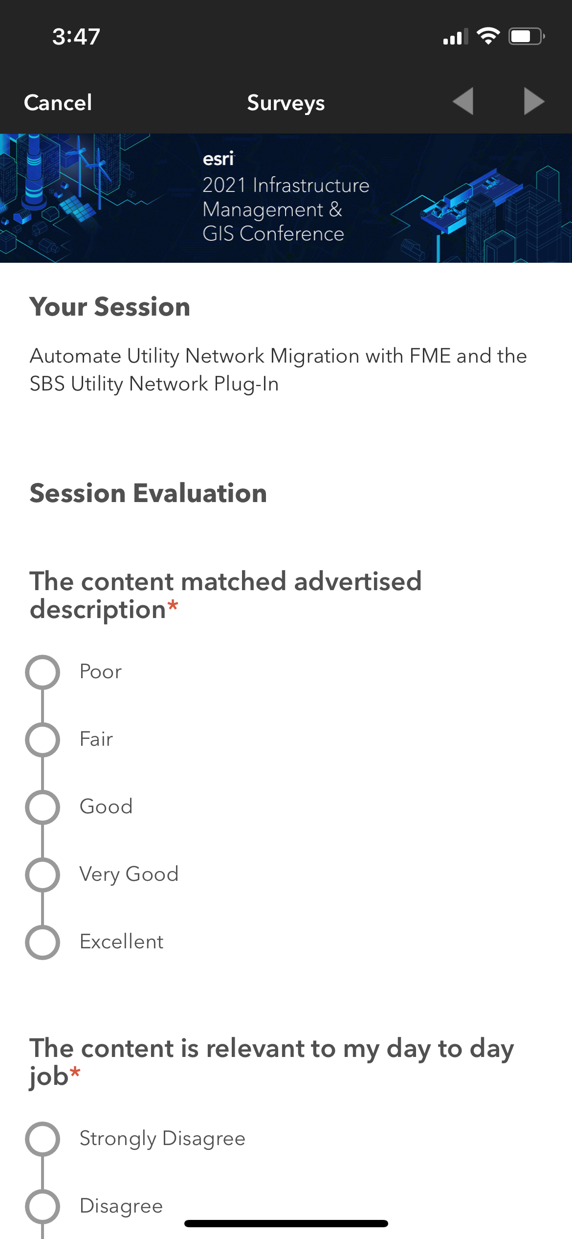
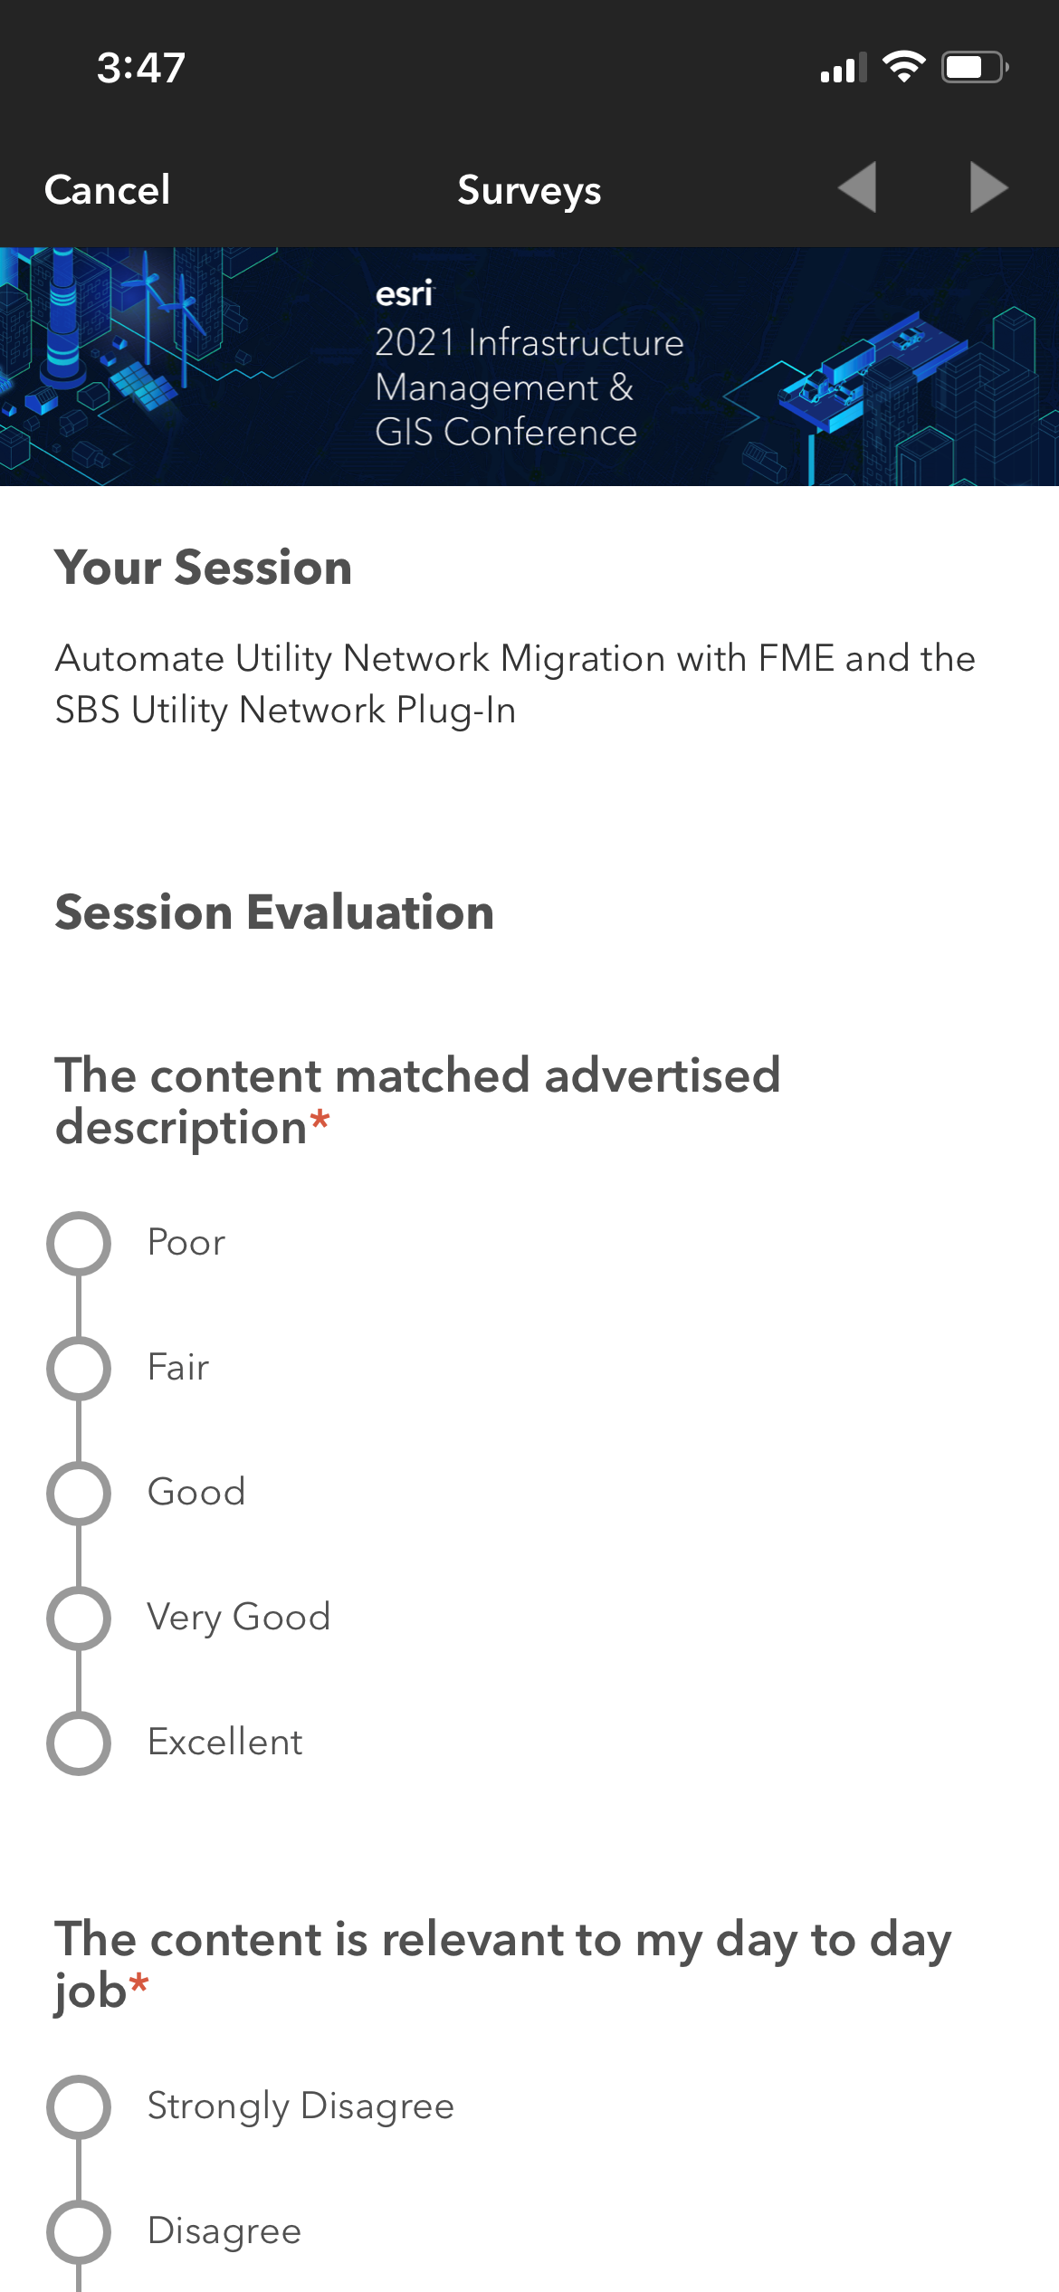
Please Share Your Feedback in the App
Download the Esri Events app and find your event
Select the session you attended
Scroll down to “Survey”
Log in to access the survey

Slide 8



Copyright © 2022 Esri. All rights reserved.

Slide 9
Headline
Subhead
Bullets

Slide 10

Section Header
Section Subhead

Slide 11

Widgets

Slide 12
Please Share Your Feedback in the App
Download the Esri Events app and find your event
Select the session you attended
Scroll down to “Survey”
Log in to access the survey

Slide 13
Copyright © 2022 Esri. All rights reserved.

